Slide 1
Titanic insights
Andy Nguyen

Slide 2
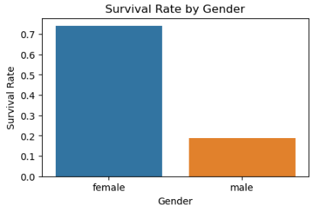

Figure 1: Survivor by Passenger Class
- Female passenger has higher ratio to survive compared to male
Figure 2: Survivor by Gender

Slide 3
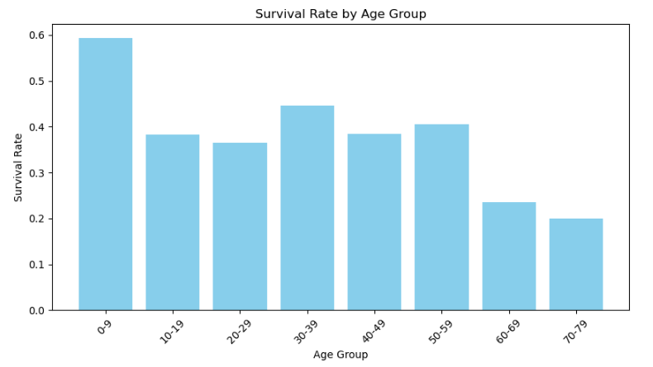
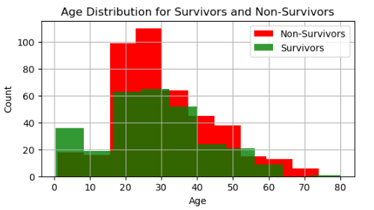
Figure 3: Age distribution for Survivors and Non-Survivors
Figure4: Survival rate by Age group
- The ratio of survived infant and kids are the highest, possibly due to their priority to be rescued first.
- In contrast, Senior Passengers (above 60 years old) get the lowest survivor rate among all of passengers.
- Young Adults (from 10 – 29 years old) who is the majority age group of the passengers but only 38% of them survived which is also a second lowest ratio.

